Slide 1



Final Enterprise
View in Power BI
Last data refresh:
1/6/2023 11:50:32 PM UTC
Downloaded at:
1/7/2023 6:48:17 PM UTC

Slide 2
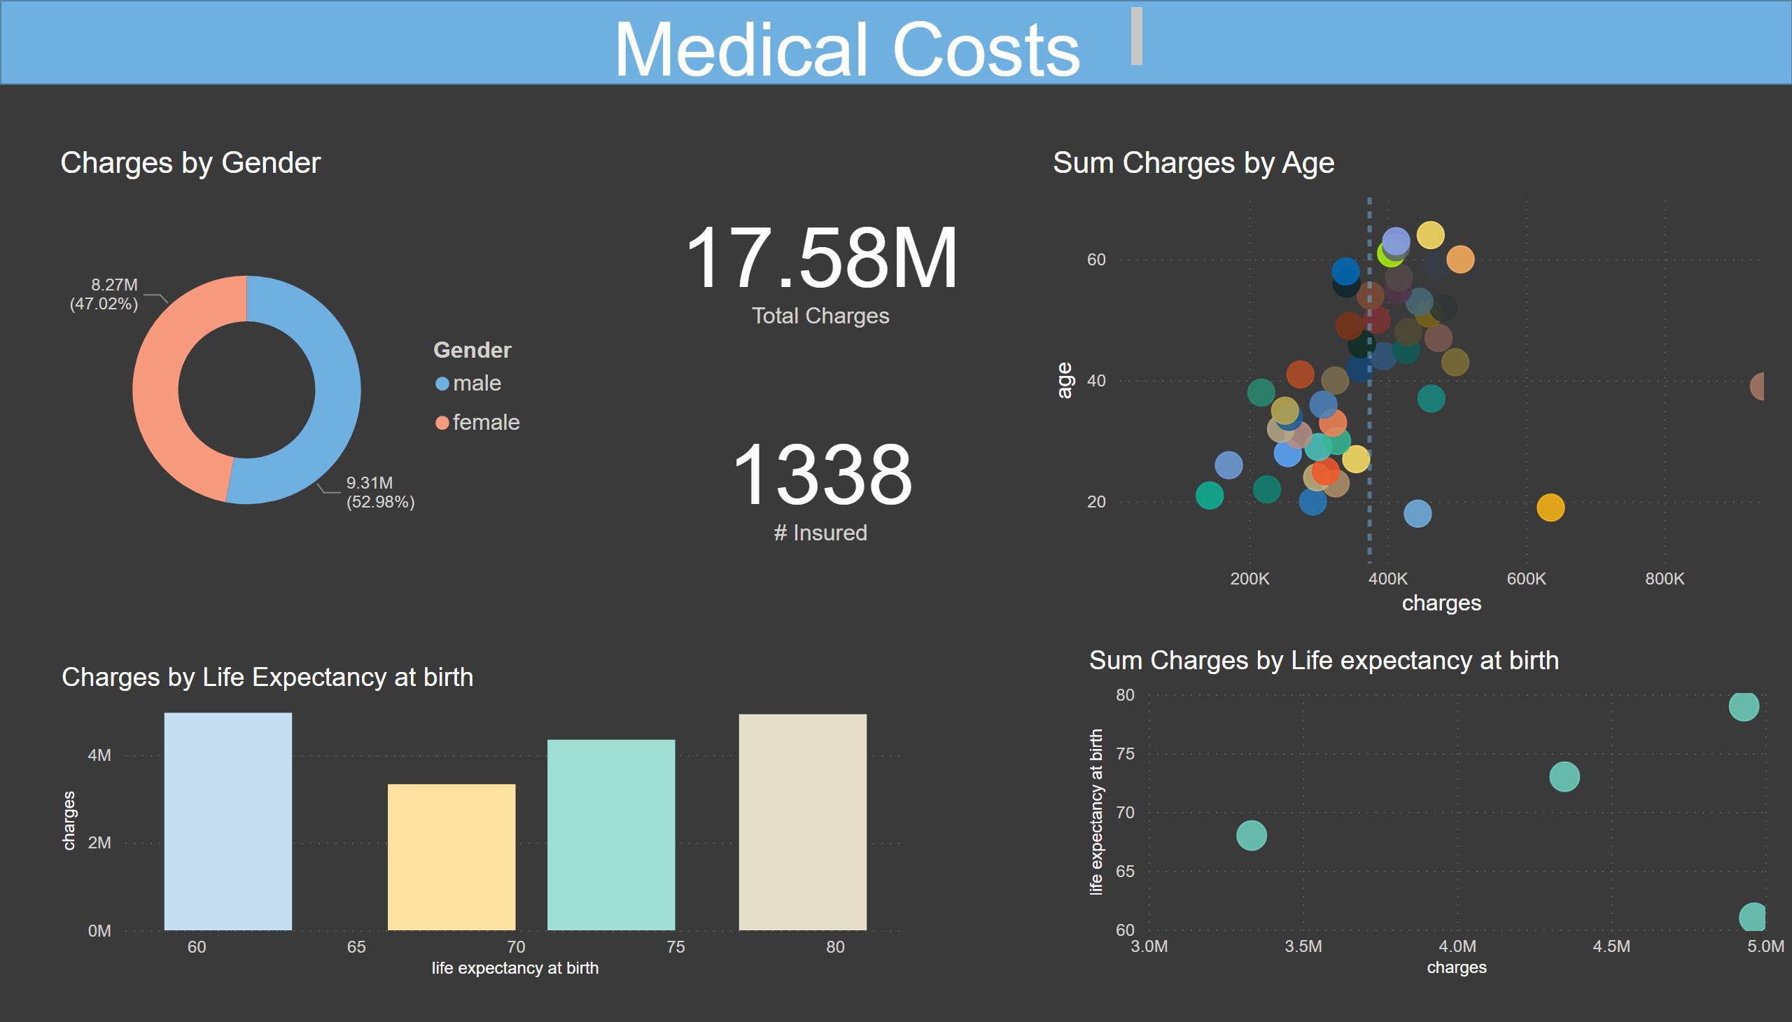
Page 1
Notes:
shape
No alt text provided
textbox
No alt text provided
Sum Charges by Life expectancy at birth
No alt text provided
card
No alt text provided
Charges by Life Expectancy at birth
No alt text provided
card
No alt text provided
Charges by Gender
No alt text provided
Sum Charges by Age
No alt text provided

